Slide 1
Chapter 5
KNOWLEDGE REPRESENTATION
Cios / Pedrycz / Swiniarski / Kurgan

Slide 2
Outline
Introduction
Main categories of data representation schemes
Granularity of data and its taxonomy
Design aspects

Slide 3
Knowledge Representation
Sources of knowledge are highly diverse and need to be represented in different ways
Representation schemes are essential for processing of data and revealing relationships
Granularity of information is a vehicle of abstraction, which is essential in description of relationships formed through data mining

Slide 4
Types of Data:
Continuous Quantitative Data
Continuous variables, such as pressure, temperature, and height
They often have some relationship to the physical phenomena that generated them
Linear order is quite common

Slide 5

Types of Data:
Continuous Quantitative Data
Linear order of real numbers

Slide 6
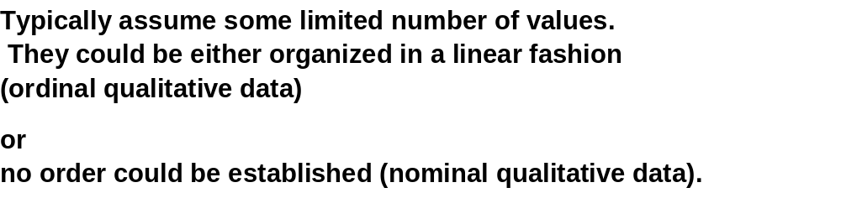
Types of Data:
Qualitative Data

Slide 7
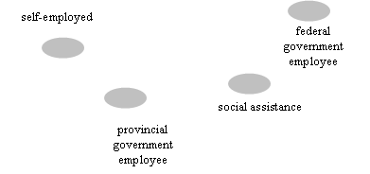
Nominal Qualitative Data

Slide 8

Ordinal Qualitative Data

Slide 9
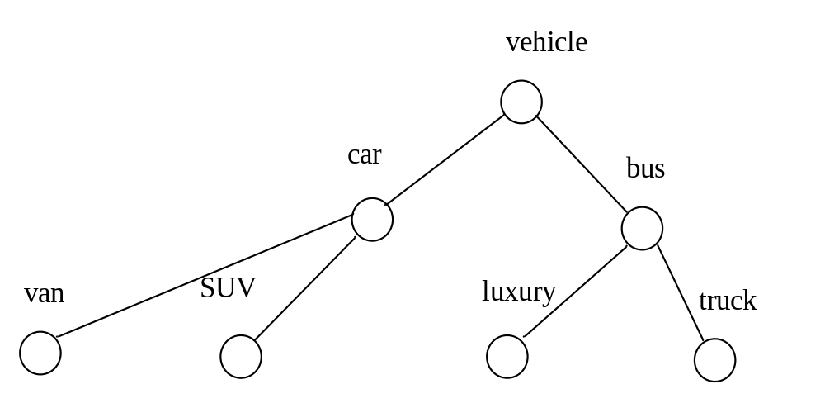
Structured Data
They form some structure that leads to a hierarchy of concepts
More specialized concepts occur at lower level of hierarchy
Tree structure is commonly used for their representation

Slide 10
Categories of Models of
Knowledge Representation
Rules
Graphs and directed graphs
Trees
Networks

Slide 11
Rules and Their Taxonomy
Generic format
IF condition THEN conclusion (action)
In general, we encounter a finite collection of rules
IF condition is A_{i} THEN conclusion is B_{i}
Often the rules are multivariable, namely, they consist
a number of variables (conditions)
- IF condition₁ and condition₂ and …. and condition_{n} THEN conclusion

Slide 12
Gradual Rules
“The higher the values of condition, the higher the values of conclusion”
or
“the lower the values of condition, the higher the values of conclusion”
They capture notion of graduality between the concepts
occurring in the conditions and conclusions
IF τ(A_{i}) THEN μ(B_{i})

Slide 13
Quantified Rules
Quantification of confidence of the rules
the likelihood that high fluctuations in real estate prices
lead to a significant migration of population within the province
is quite moderate.
Confidence of rule

Slide 14
Analogical Rules
Focus on analogy (similarity, closeness, resemblance…)
between conditions and conclusions
IF similarity (A_{i}, A_{j}) THEN similarity (B_{i}, B_{j})
express analogy

Slide 15
Rules with Regression
Local Models
More advanced and functionally augmented conclusion part
of the rule. It involves some regression model
IF condition is A_{i} THEN y = f_{i}(x, a_{i})
local regression model

Slide 16
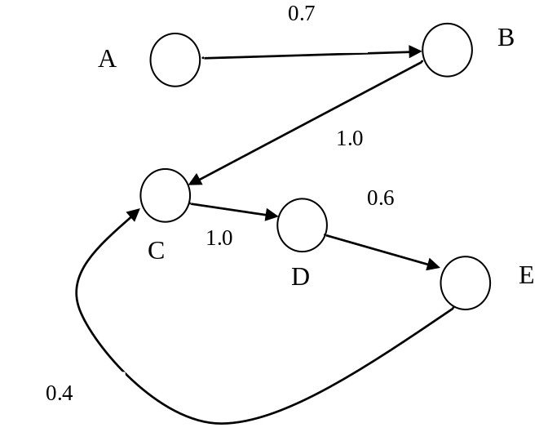
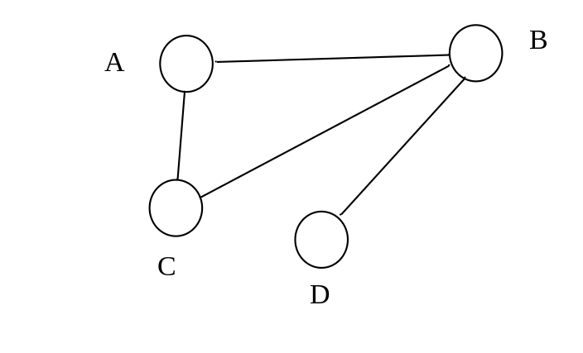
Graphs and Directed Graphs
Concepts and links express relationships between the concepts.
Two main categories of graphs:
(a) undirected graphs
(b) directed graphs

Slide 17
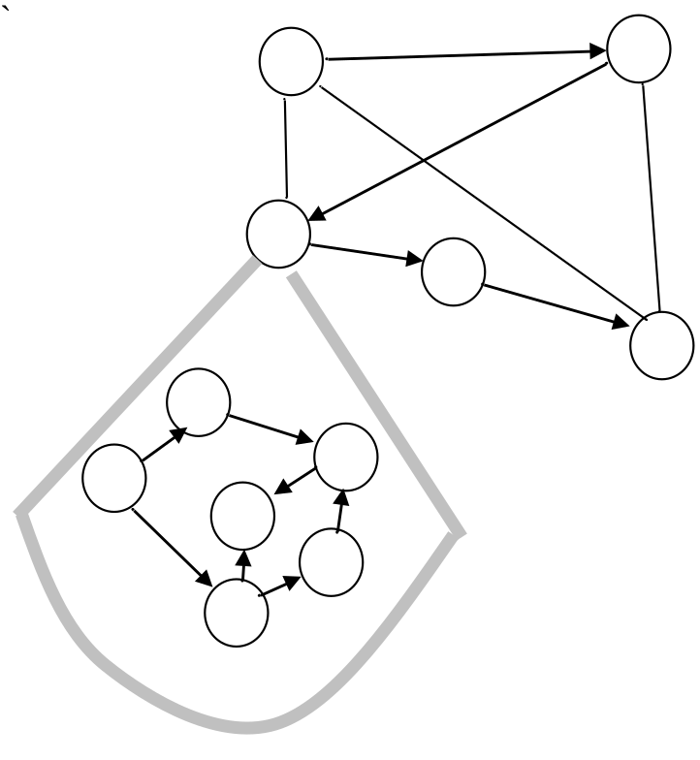
Hierarchy of Graphs
Refinement of relationships starting from the most general
relationships (with general nodes) and expansion of the nodes

Slide 18
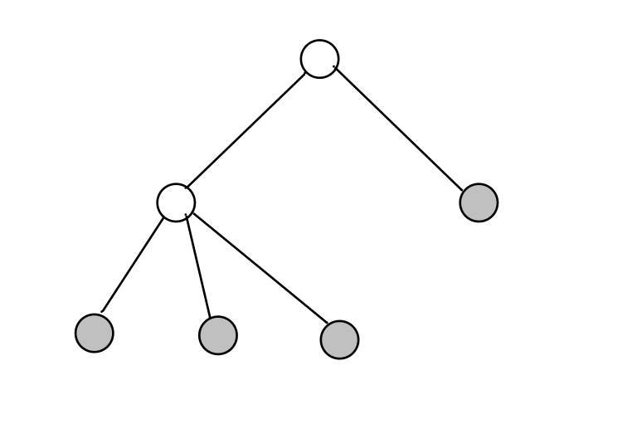
Trees
An important category of graphs with
Single root
No loops
Terminal nodes
root
Terminal nodes

Slide 19
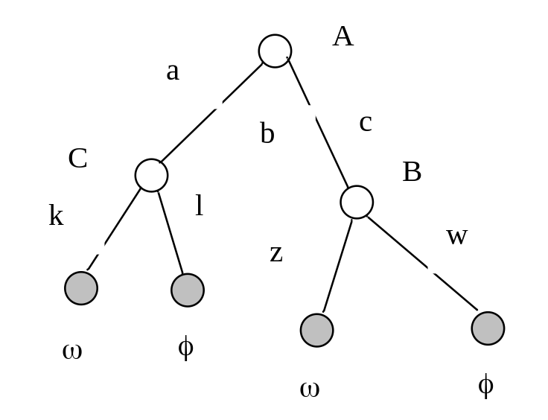
Decision Trees
Decision tree → rules
IF A is c and B is w THEN φ
IF A is c and B is z THEN ω
IF A is a and C is k THEN ω
IF A is a and C is l THEN φ

Slide 20
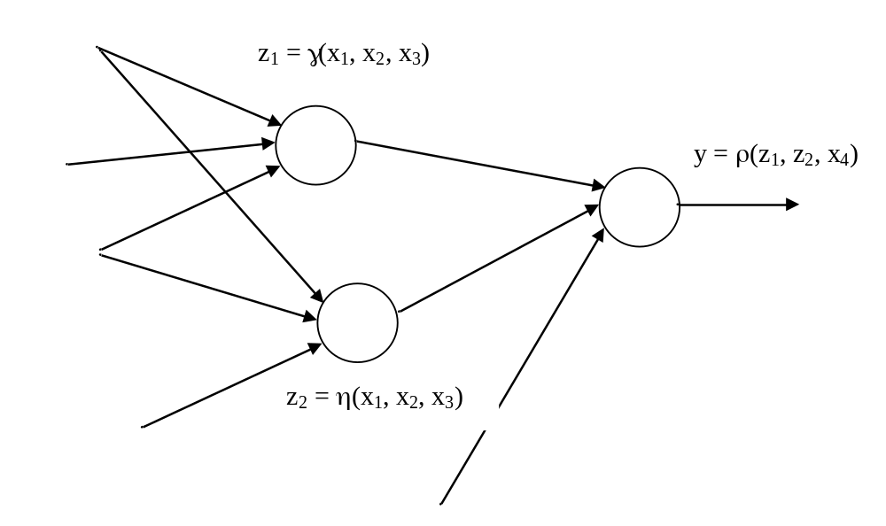
Networks
Generalized graphs with nodes endowed with some
processing capabilities
For instance:
Each node computes some logic formula using input variables and
logic operators (conjunction, disjunction, complement)
(b) Node could be a local neural network

Slide 21
Information Granules and Information Granularity
Information granules support human-centric computing
By human-centricity we mean characteristics of computing systems
that facilitate interaction with humans either by
improving the quality of communication of findings or
by accepting inputs from users in a flexible and friendly manner, say, in a linguistic form.
Information granules permeate human endeavors. Any given task can be cast into a certain conceptual framework of relevant generic entities; this is the framework in which we:
formulate generic concepts at some level of abstraction
carry out processing
communicate the results to the user/external environment

Slide 22
Information Granules:
Examples
Image processing
Humans do not focus on individual pixels but group them together into
semantically meaningful constructs such as:
regions that consist of groups of pixels drawn together owing to their
proximity in the image, similar texture, color, level of brightness, etc.
Signal processing
We describe signals in a semi-qualitative manner by identifying specific regions
of the signals in time or frequency domain.
E.g., specialists easily interpret ECG signals by identifying some segments
and their combinations.

Slide 23
Granular Computing: an Emerging Paradigm
Identifies essential commonalities between diverse problems and technologies, cast into a unified framework we refer to as a
granular world.
With granular processing we better understand the role of interaction between various formalisms and might visualize a way in which they communicate.
It brings together the formalisms of sets, fuzzy sets and rough sets, by visualizing that in spite of their distinct underpinnings,
the granular computing establishes an environment for building synergy between different individual approaches.

Slide 24
Granular Computing:
Key Formal Frameworks
Set theory (interval analysis)
Fuzzy Sets
Rough Sets
Shadowed Sets

Slide 25


Sets
Notion of Membership
belongs to excluded from

Slide 26


Characteristic Functions
Concept of dichotomy

Slide 27
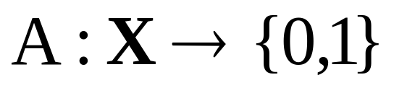
Description of Sets
Membership
  enumerate elements belonging to the set
Characteristic function
1
A(x)=0
0
A(x)=1

Slide 28
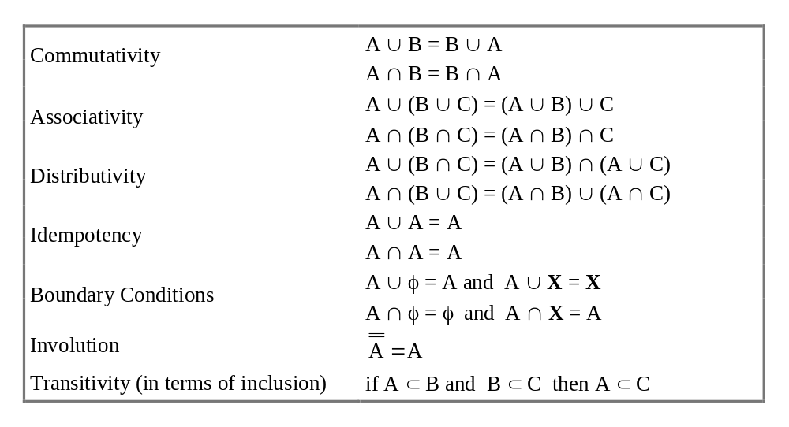
Basic Operations on Sets

Slide 29
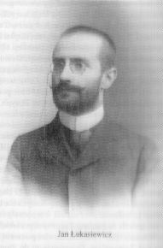
Challenge:
Three-valued Logic
Lukasiewicz (~1920)
true (0)
false (1)
don’t know (1/2)
Three valued logic

Slide 30

Fuzzy set - Definition
Fuzzy set A is described by its membership function A(x)
A(x) =1: complete membership
A(x) =0: complete exclusion

Slide 31
Fuzzy Sets:
Membership Functions
Partial membership of element to the set – membership degree A(x)
The higher the value of A(x), the more typical the element “x” (as a representative of A)

Slide 32
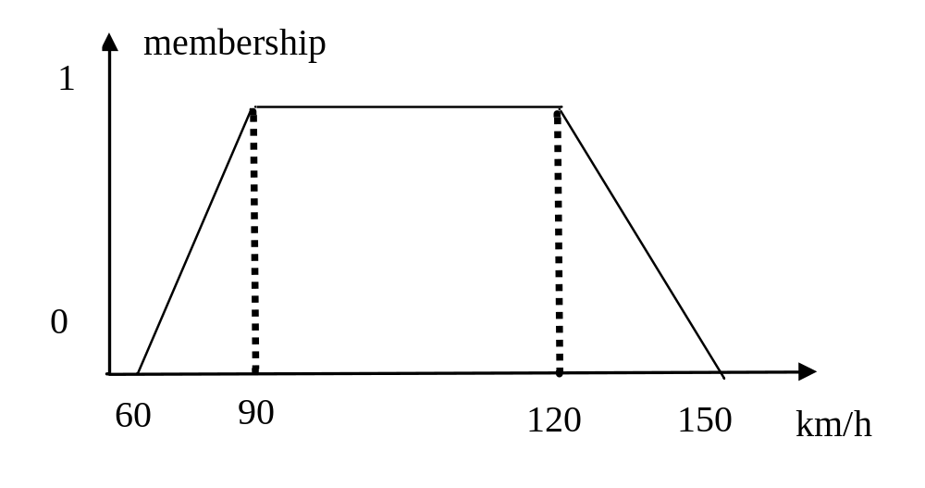
Membership Functions:
Examples

Slide 33
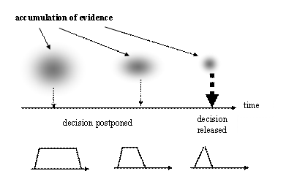
Principle of the Least Commitment

Slide 34
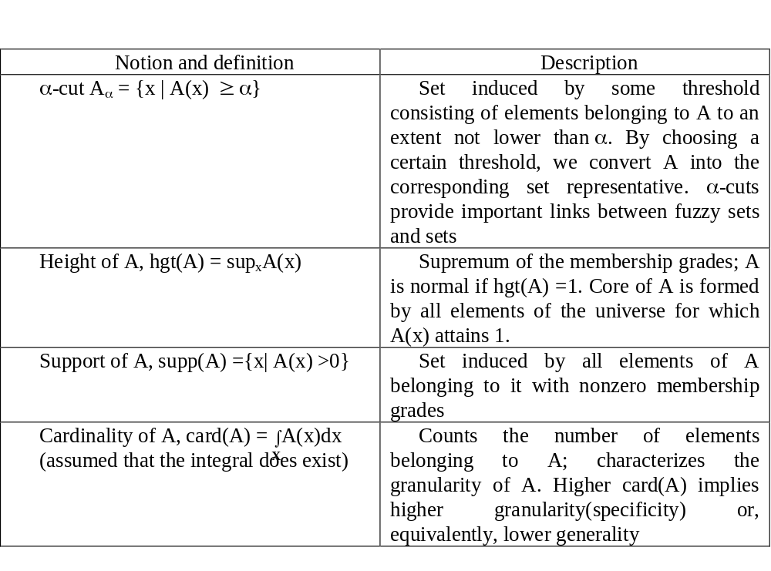
Characteristics of Fuzzy Sets

Slide 35
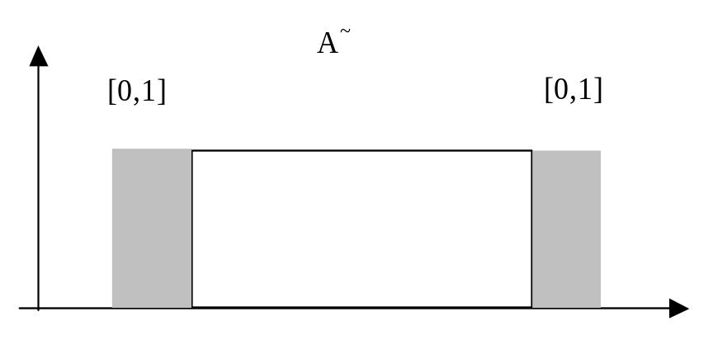
Shadowed Sets
Granular constructs in which we allow for regions of space of
complete ignorance
A~ : X → { 0, 1, [0,1]}
Exclusion Full membership Ignorance

Slide 36
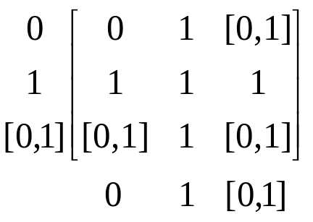
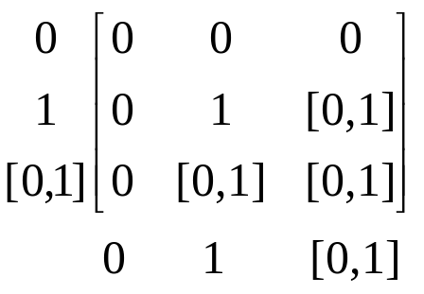
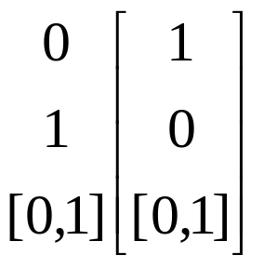
Shadowed Sets:
Logic Operations
Union Intersection
complement

Slide 37
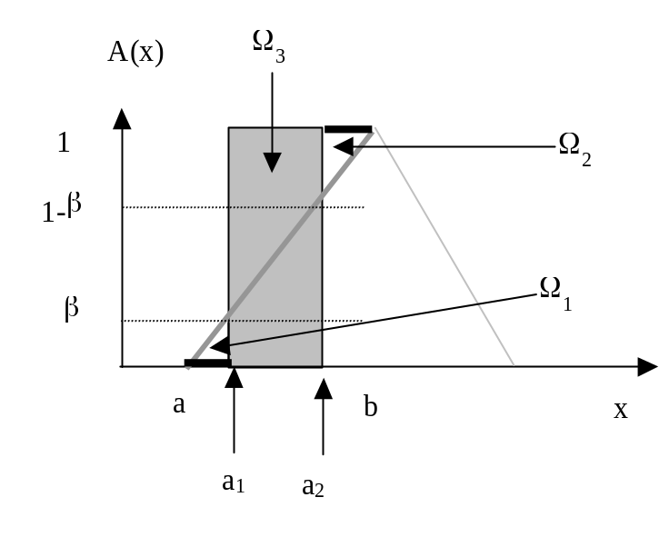
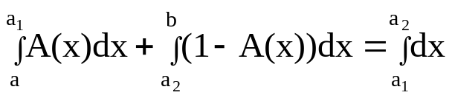
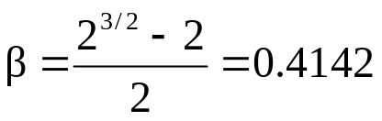
Shadowed Sets:
Estimation Method
Shadowed sets are generated (induced) on a basis of fuzzy sets:
Re-allocation of membership grades
(a) low membership grades reduced to zero
(b) high membership grades elevated to 1
(c) membership grades resulting from the reduction and elevation
are used in the formation of shadows
Ω₁ + Ω₂ = Ω₃
Linear membership function:

Slide 38
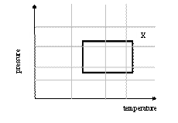
Rough Sets
Defining concept X with the use of a finite vocabulary of
information granules:
Lower bound (approximation)
Upper bound (approximation)

Slide 39
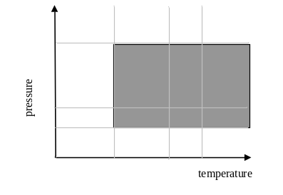
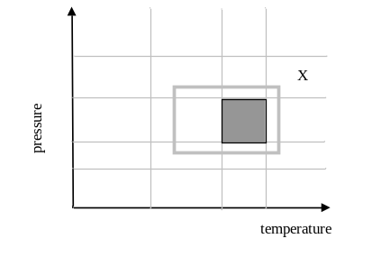
Rough Sets :
Upper and Lower Approximations
A_{i}
upper approximation
lower approximation

Slide 40
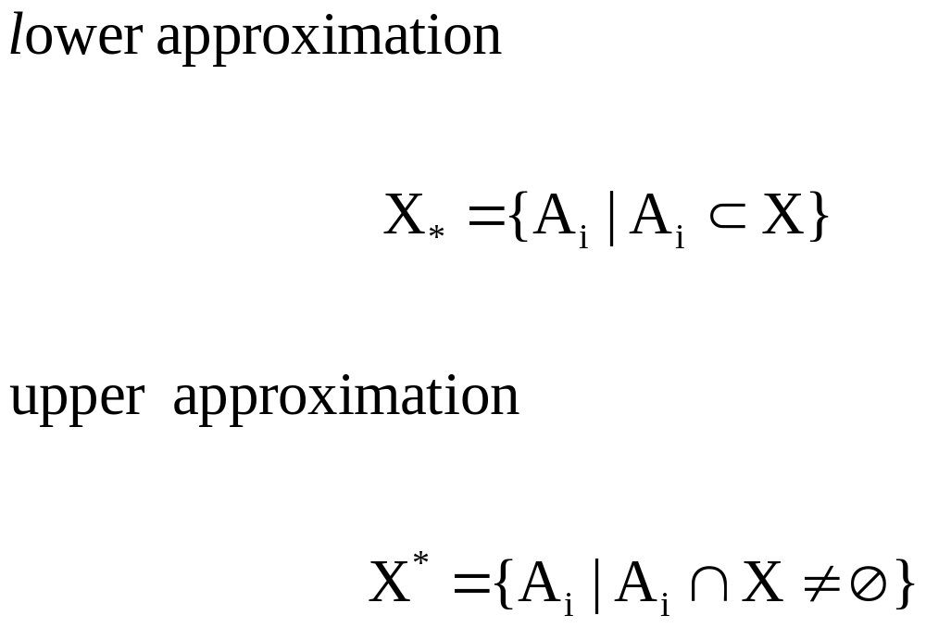
Rough Sets :
Upper and Lower Approximations

Slide 41
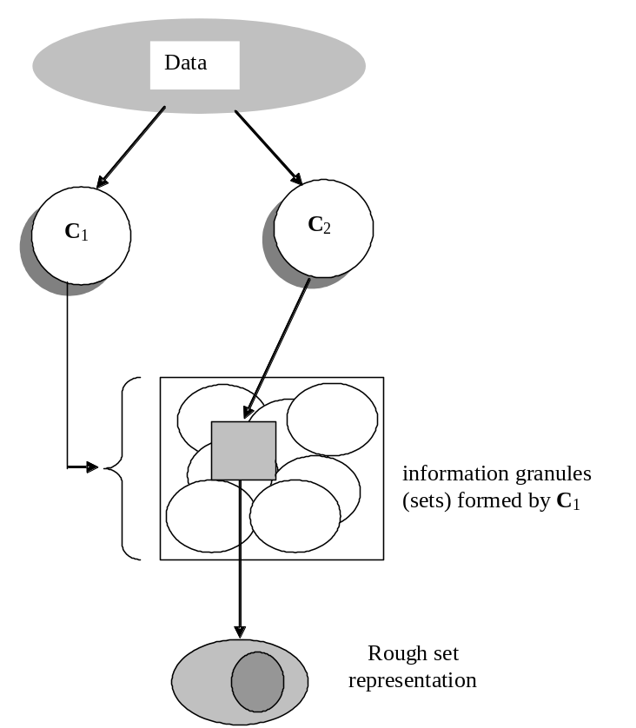
Rough Sets:
The Principle of Data Description
Given some information granules
they are used to characterize other granular view at data

Slide 42
Characterization of
Knowledge Representation Schemes
Expressive power of the scheme
Computational complexity and associated tradeoffs :
- Flexibility of knowledge representation – familiarity of the users
with a specific scheme of knowledge representation
- Effectiveness of forming models on the basis of domain knowledge
and experimental data
- Character of information granulation and the level of specificity of
information granules

Slide 43

Information Granularity
Information granules are defined at different levels of specificity
(abstraction) which is reflective of their “size”
We define measures that characterize the size of information granules
Information granules | Granularity
Fuzzy sets | In the case of a finite space X, the integral is replaced by a sum of the membership grades
Rough sets | Cardinality of the lower and upper bound, card (A₊), card (A₋); the difference between these two describes roughness of A

Slide 44
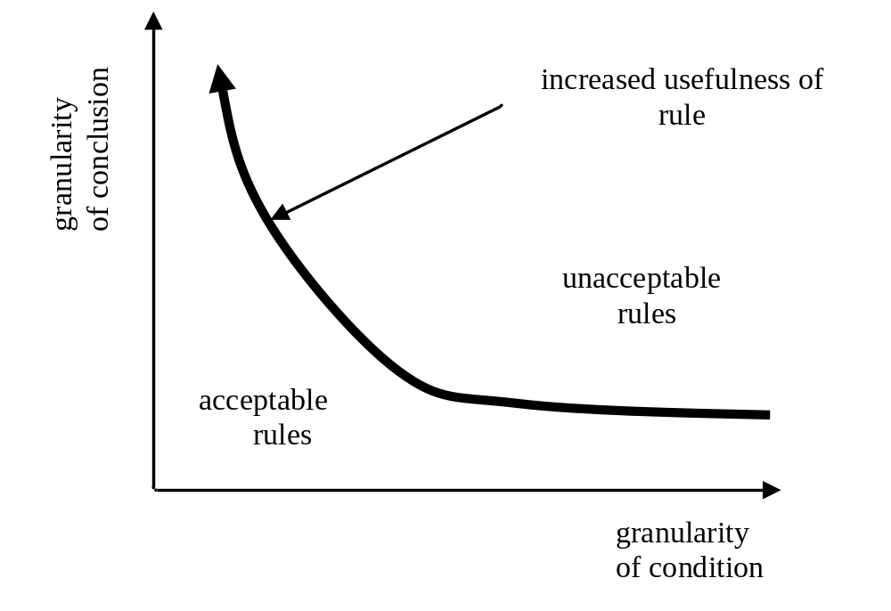
Information Granularity in Rule-based Systems

Slide 45
References
Bargiela A and Pedrycz W. 2003. Granular Computing: An Introduction,
Kluwer Academic Publishers
Giarratano J and Riley G. 1994. Expert Systems: Principles and Programming,
2nd Ed., PWS Publishing
Moore R. 1966. Interval Analysis, Prentice Hall
Pal SK and Skowron A (eds.) 1999. Rough Fuzzy Hybridization.
A New trend in Decision-Making, Springer Verlag
Pawlak Z. 1991. Rough Sets. Theoretical Aspects of Reasoning About Data,
Kluwer Academic Publishers
Pedrycz W and Gomide F. 1998. An Introduction to Fuzzy Sets; Analysis and Design.
MIT Press, 1998.
Pedrycz W (ed.). 2001. Granular Computing: An Emerging Paradigm, Physica Verlag
Zadeh LA. 1965. Fuzzy sets, Information & Control, 8, 1965, 338-353.

